Slide 1
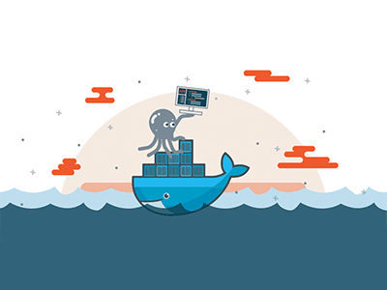

Introduction to docker

Slide 2
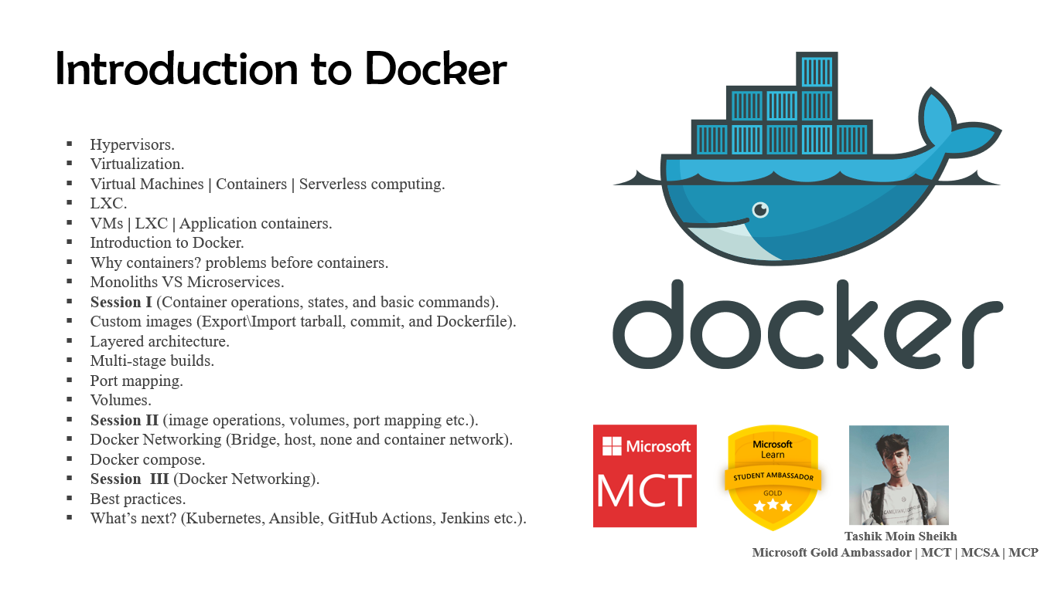

Slide 3
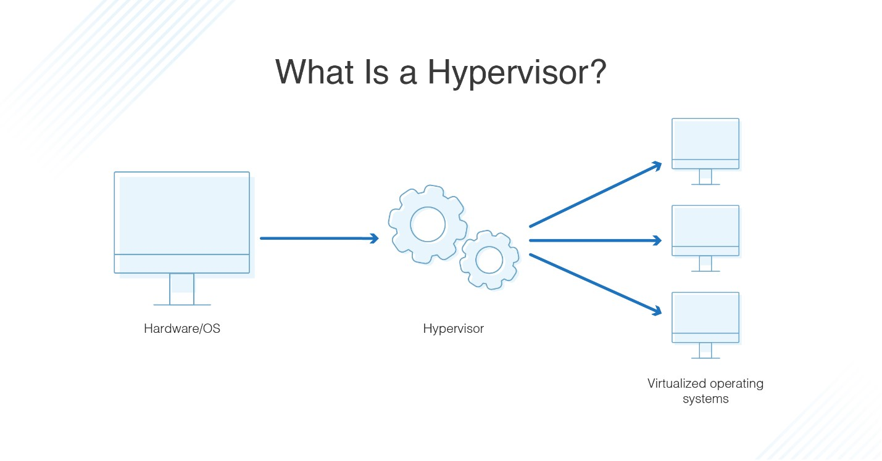

Hypervisor
A hypervisor, also known as a virtual machine monitor or VMM, is software that creates and runs virtual machines (VMs). A hypervisor allows one host computer to support multiple guest VMs by virtually sharing its resources, such as memory and processing.

Slide 4
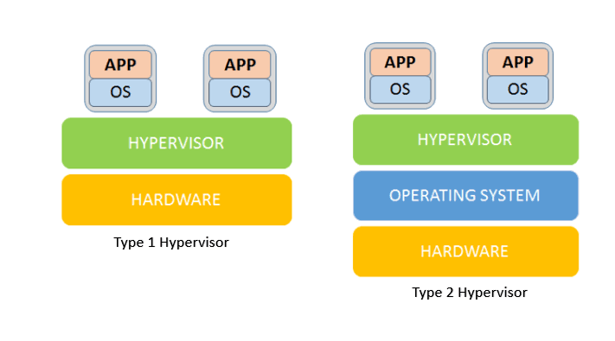
Bare metal (Type 1) vs hosted (type 2)
ESXi, Hyper-V, and Apple Boot Camp etc.
MSFT Virtual PC, Virtual Box, VMware Workstation etc.

Slide 5
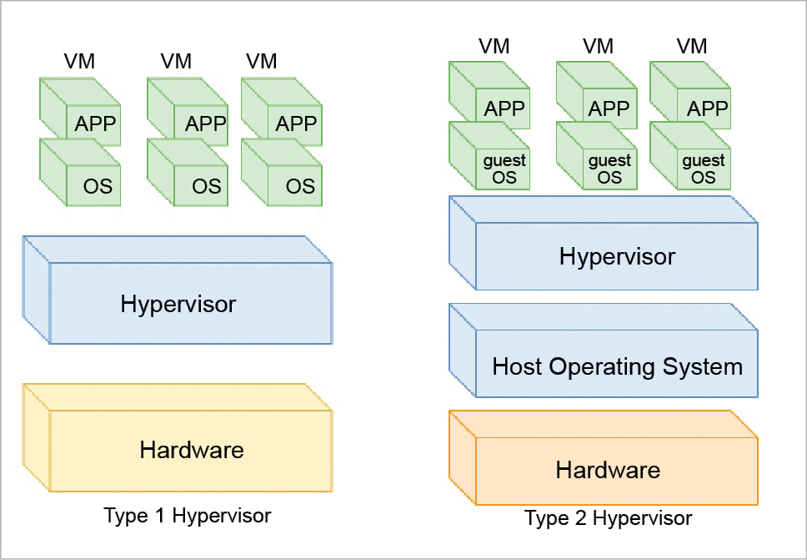

Slide 6
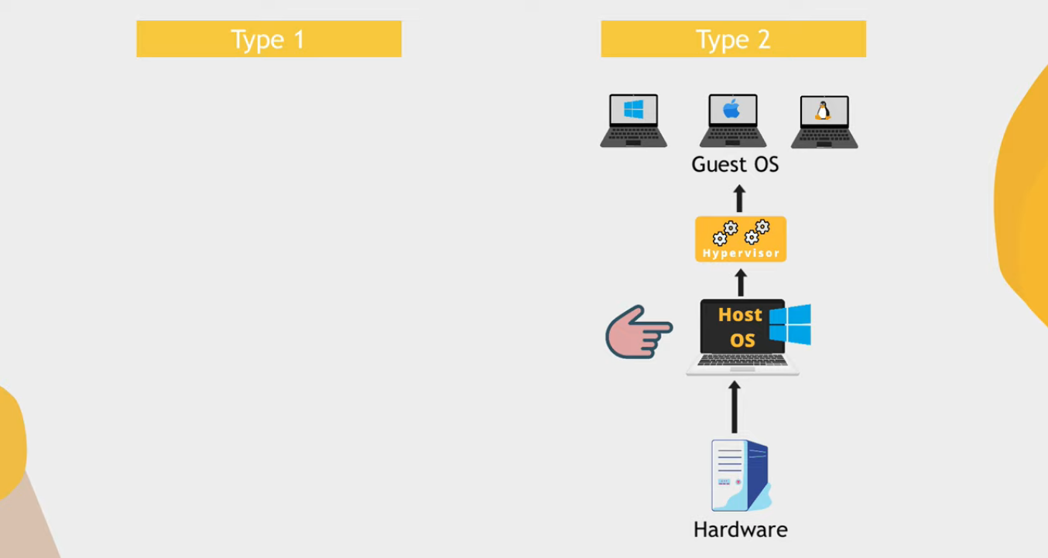

Slide 7
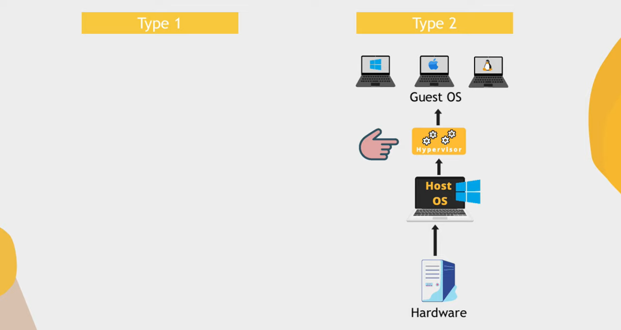

Slide 8
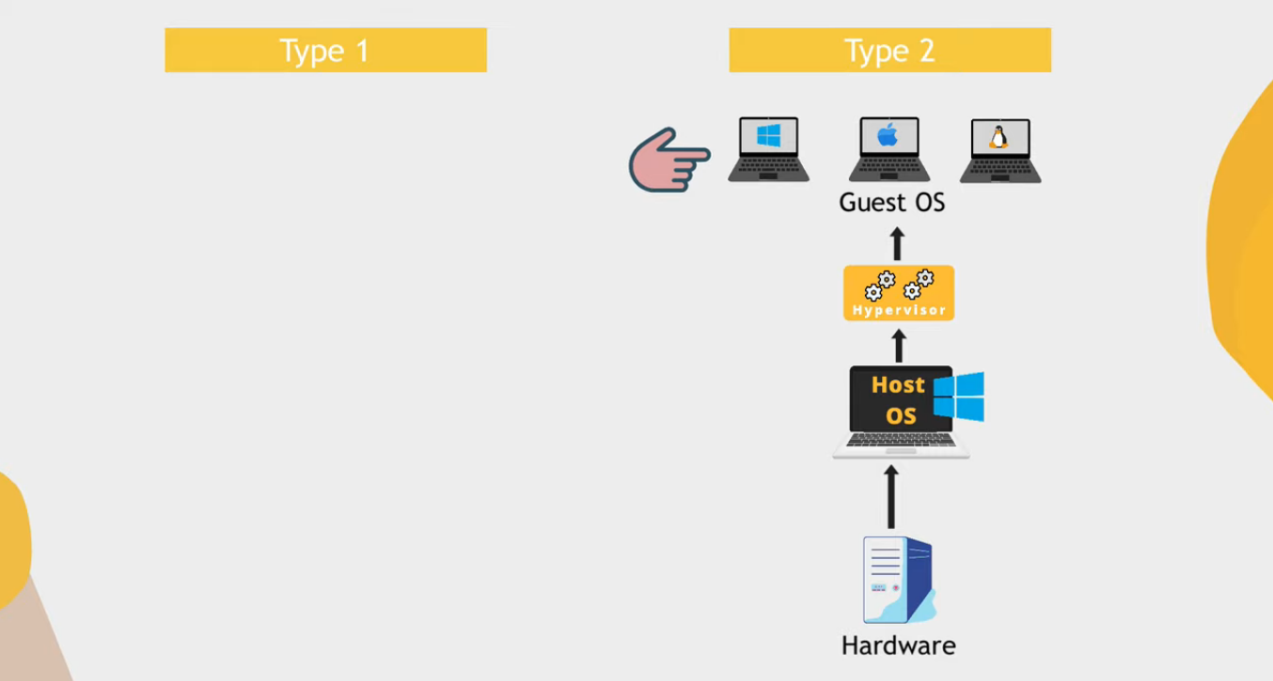

Slide 9
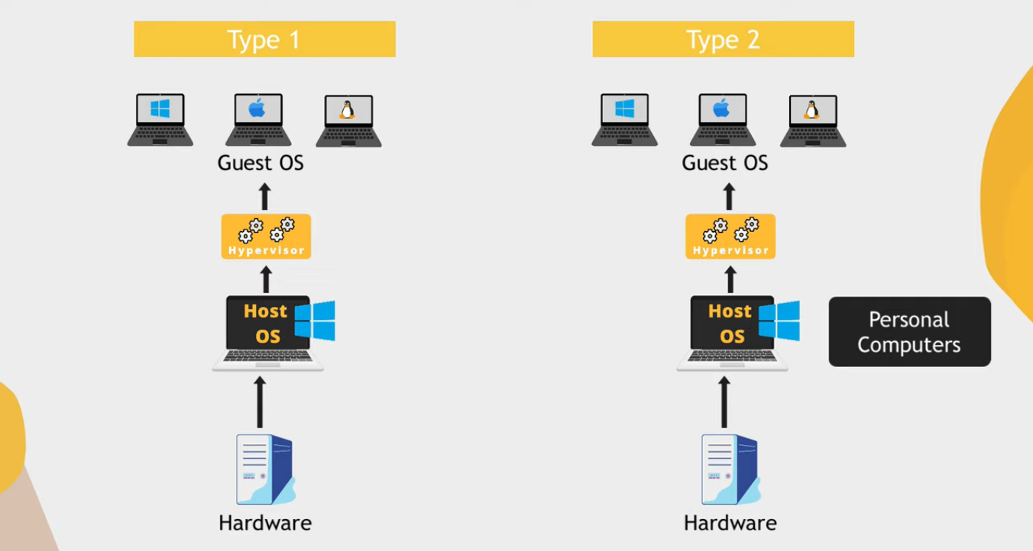
“Can only allocate host OS resources for virtualization”
“Same hardware resources”

Slide 10
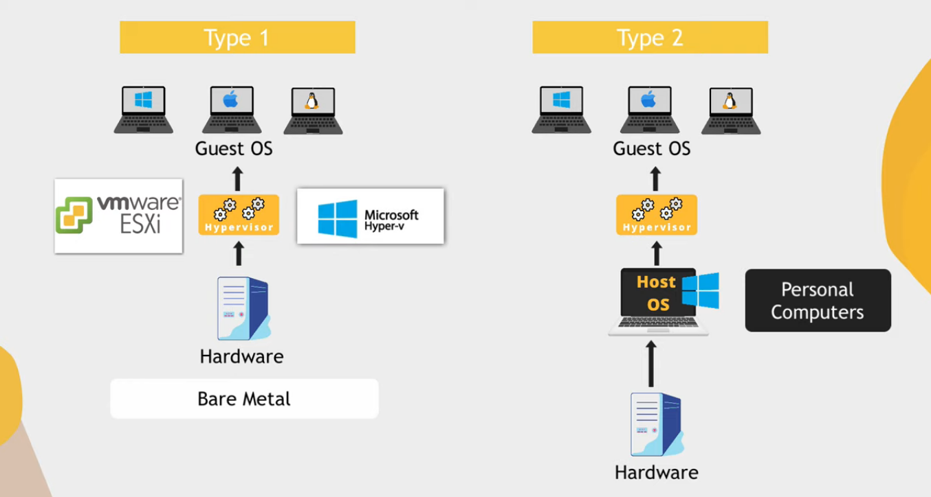

Slide 11
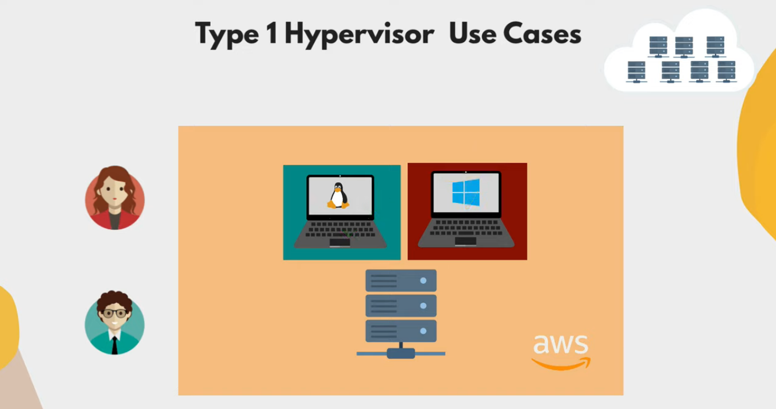

Slide 12
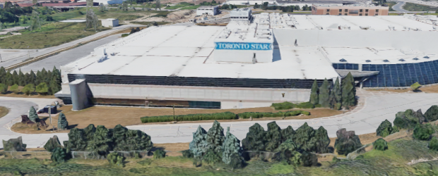
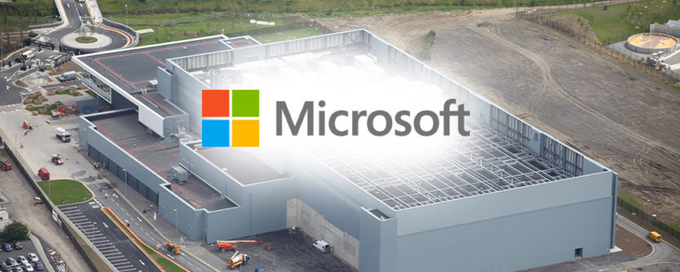
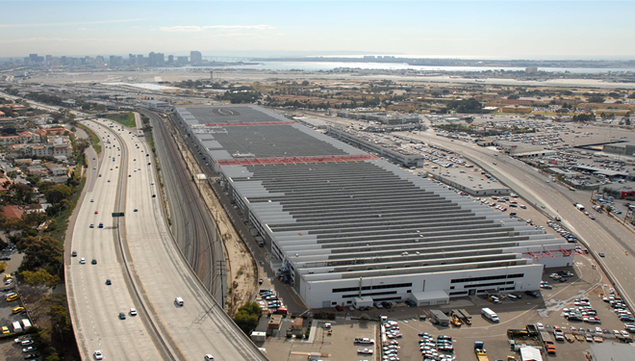
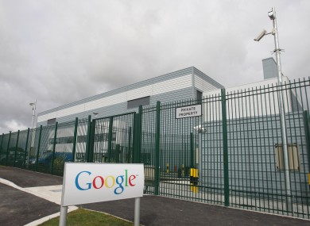
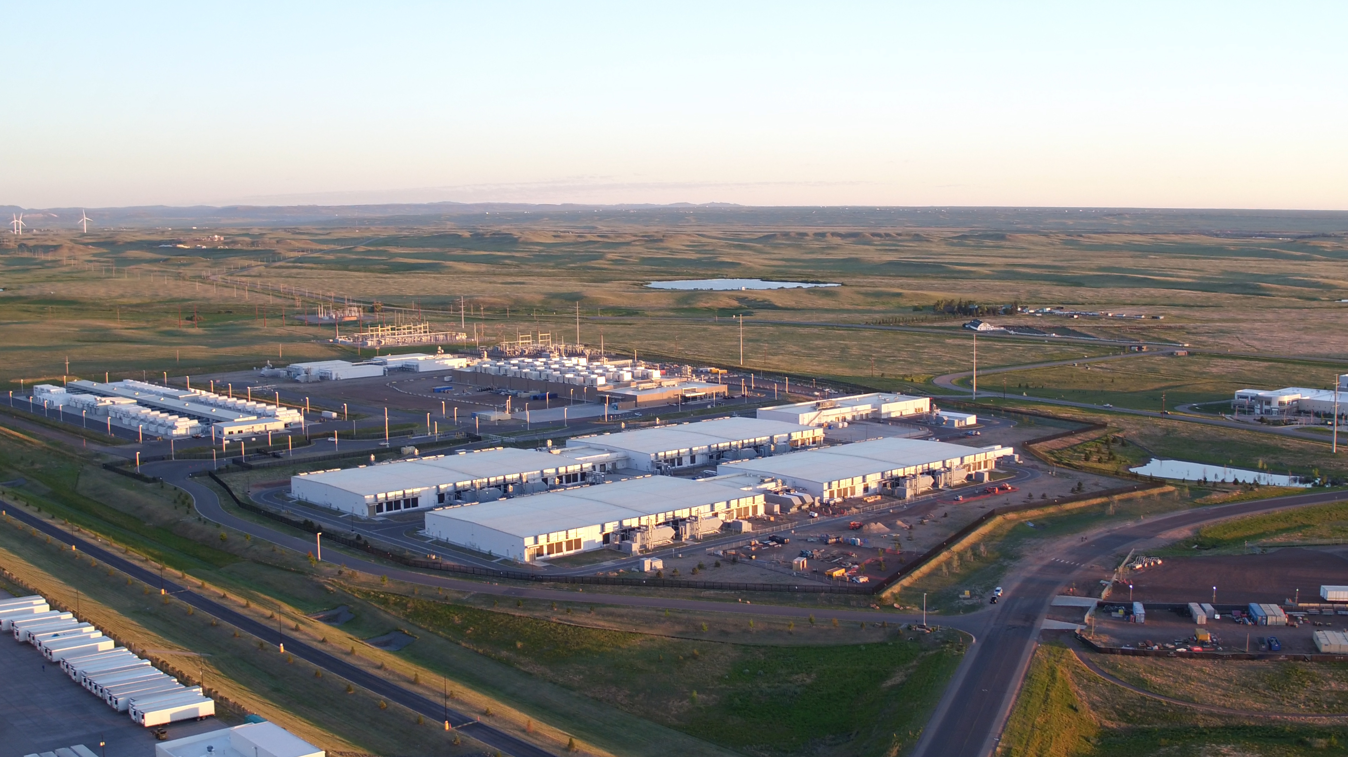
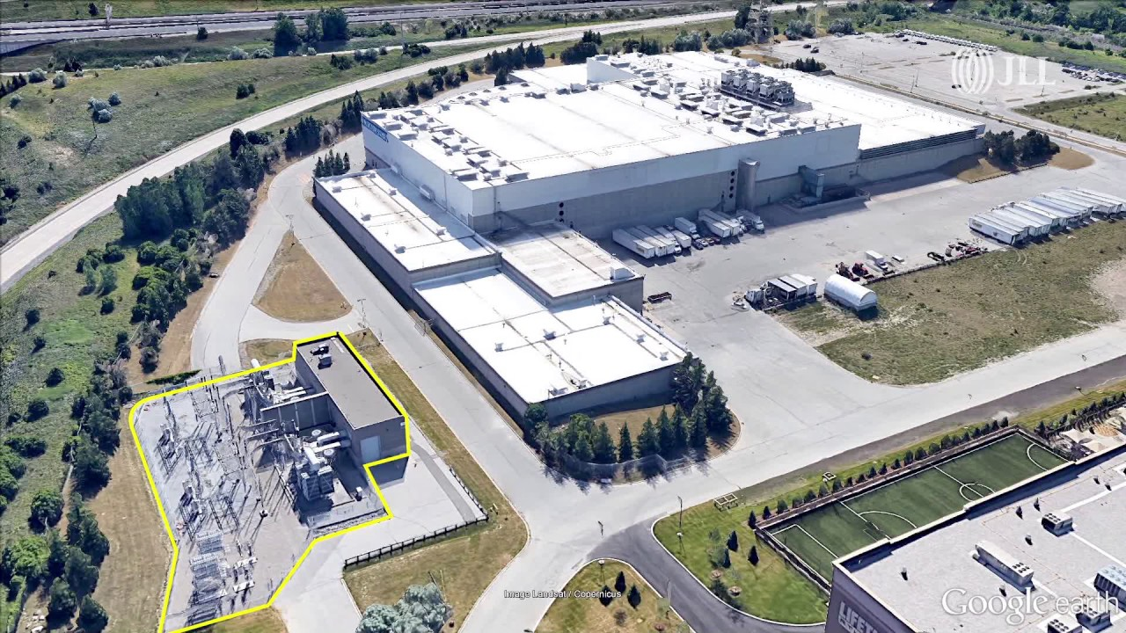

Slide 13
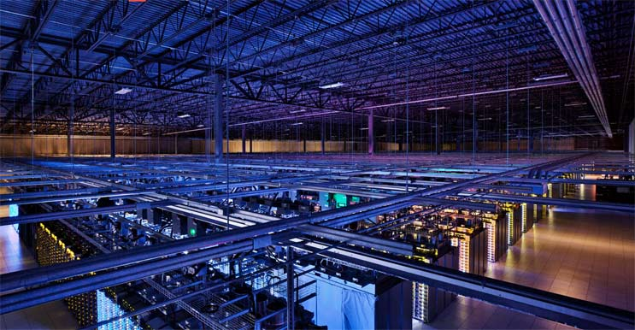
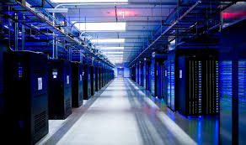
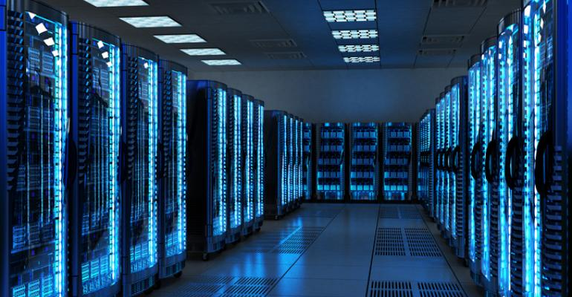
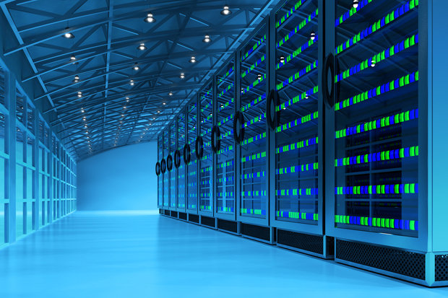

Slide 14
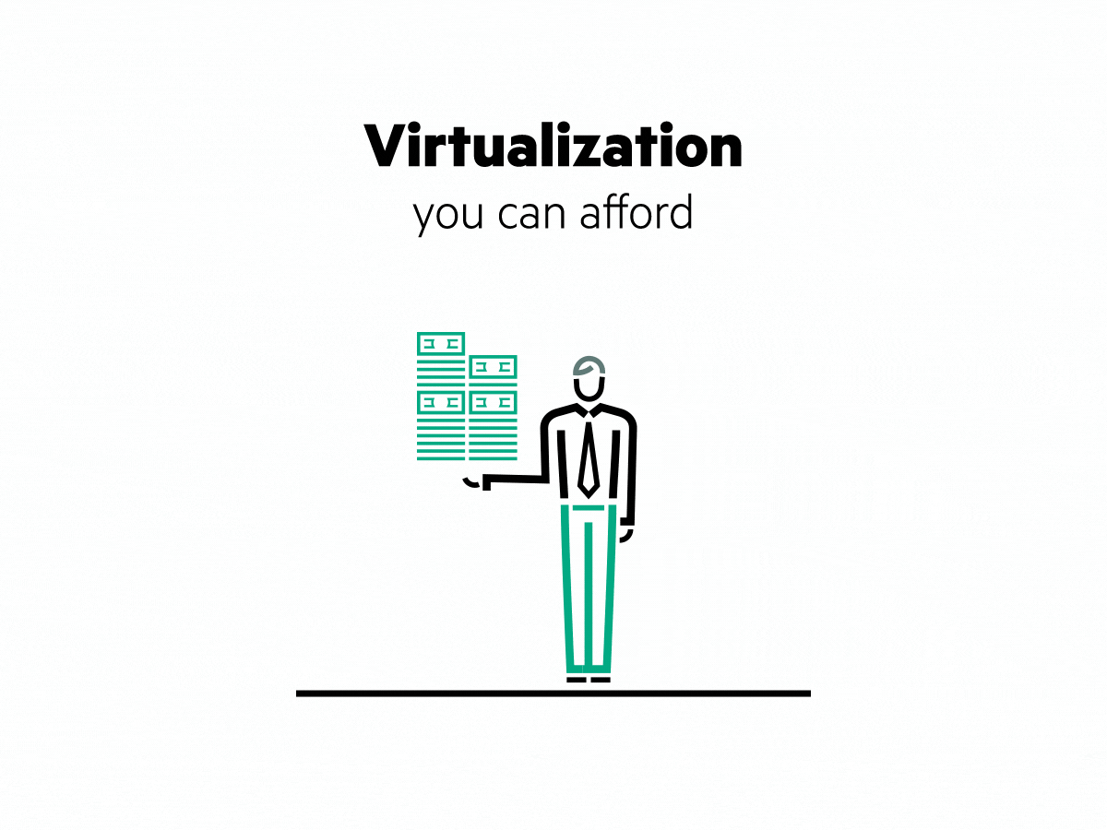
virtualization
Virtualization is the process of running a virtual instance of a computer system in a layer abstracted from the actual hardware. Most commonly, it refers to running multiple operating systems on a computer system simultaneously. Virtualization is the creation of a virtual -- rather than actual -- version of something, such as an operating system (OS), a server, a storage device or network resources. Virtualization uses software that simulates hardware functionality in order to create a virtual system Virtualization refers to the creation of a virtual resource such as a server, desktop, operating system, file, storage or network. The main goal of virtualization is to manage workloads by radically transforming traditional computing to make it more scalable.

Slide 15
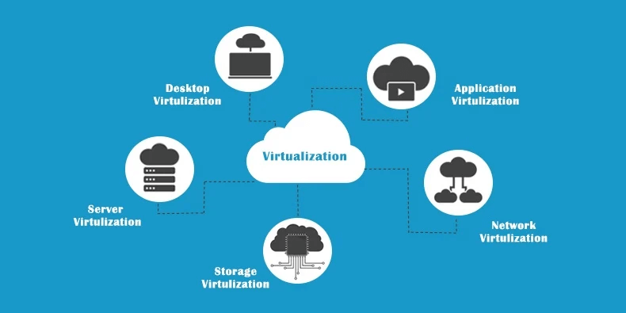

Slide 16
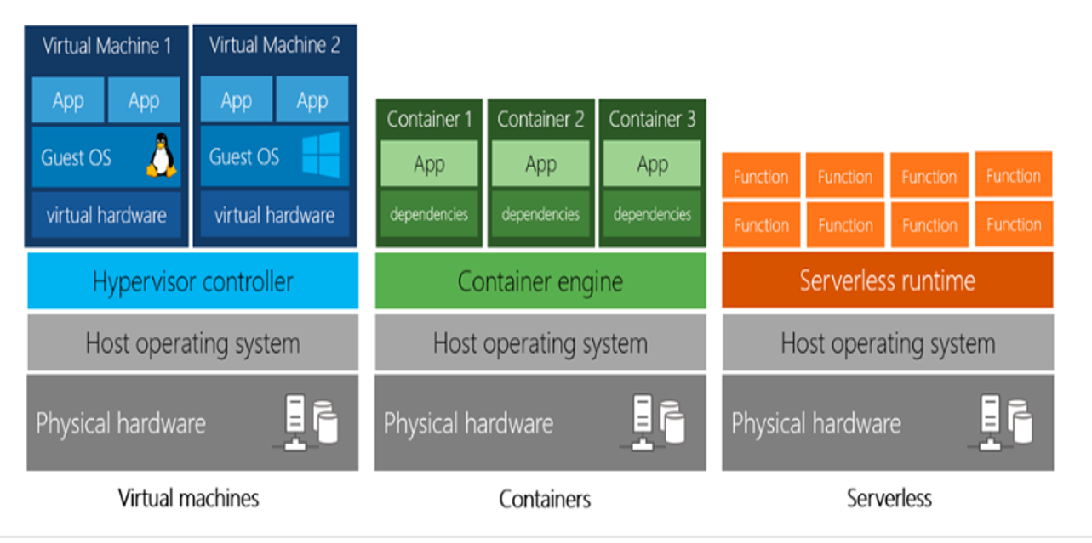
Virtual machines vs containers VS serverless

Slide 17
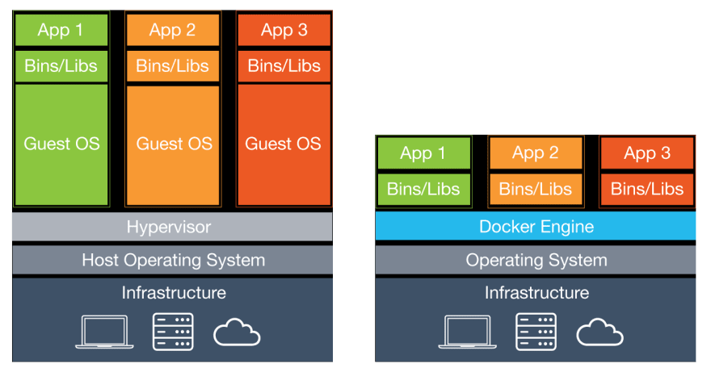
Virtual machines vs containers

Slide 18
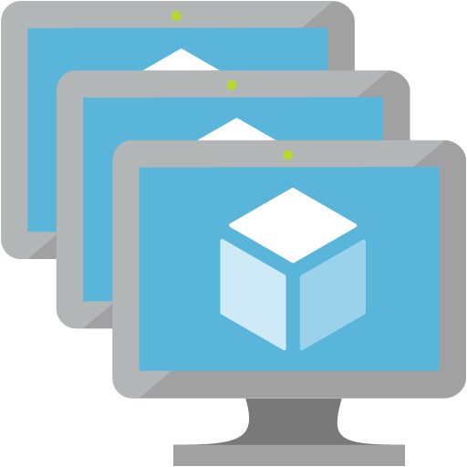
Virtual machines
Definition
Virtual machines are software computers that provide the same functionality as physical computers. Like physical computers, they run applications and an operating system. However, virtual machines are computer files that run on a physical computer and behave like a physical computer. In other words, virtual machines behave as separate computer systems.
Types Of Virtual Machines Process Virtual Machines Execute computer programs in a platform-independent environment. It masks the information of the underlying hardware or operating system. This allows the program to be executed in the same fashion on any platform. Example : JVM, .NET Core CLR etc.
System Virtual Machines
Support the sharing of a host computer’s physical resources between multiple virtual machines.
Example : Virtual Machines Created From VMware.

Slide 19
The JVM is called a virtual machine because the JVM definition defines an abstract machine. This includes registers, stack, etc., and the byte code that Java source is compiled to is practically machine code for this virtual machine. The JVM then interprets or compiles this byte code into native machine instructions.

Slide 20
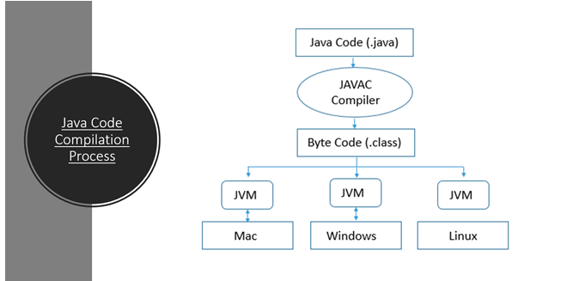

Slide 21
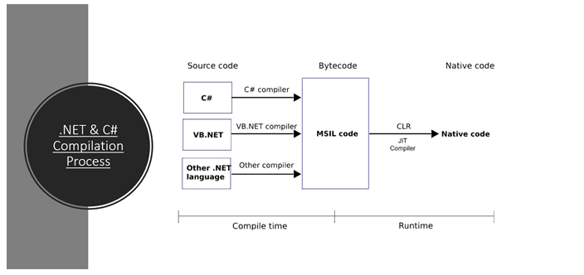

Slide 22
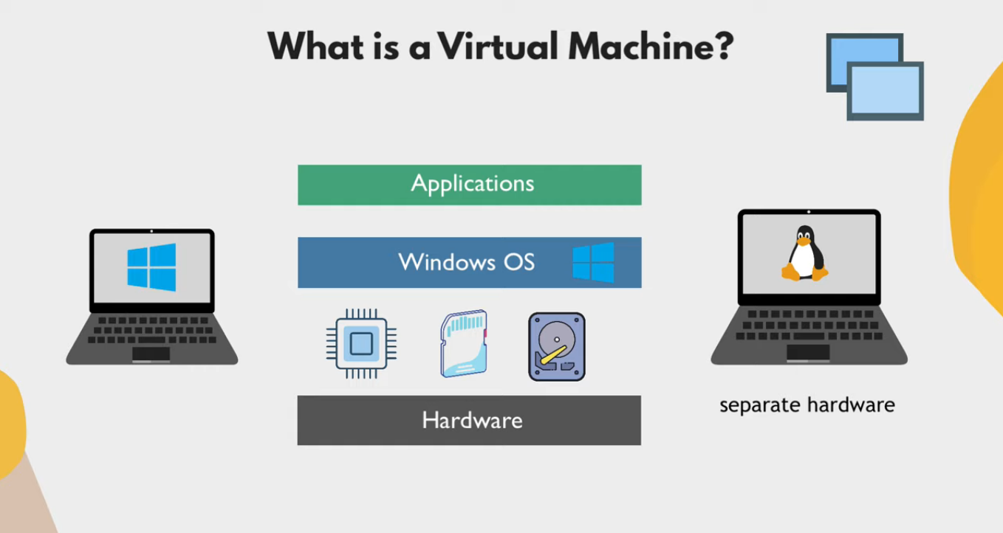

Slide 23
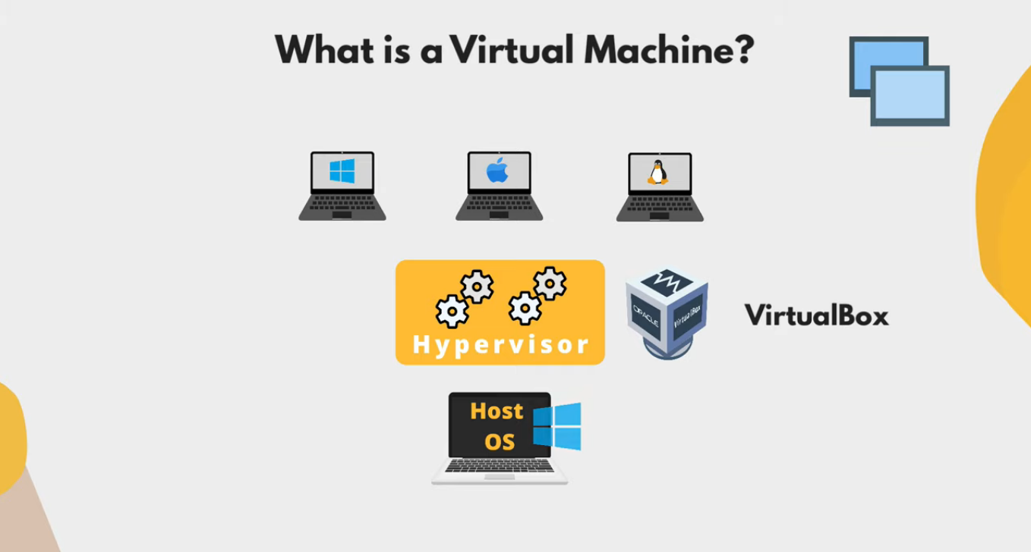

Slide 24
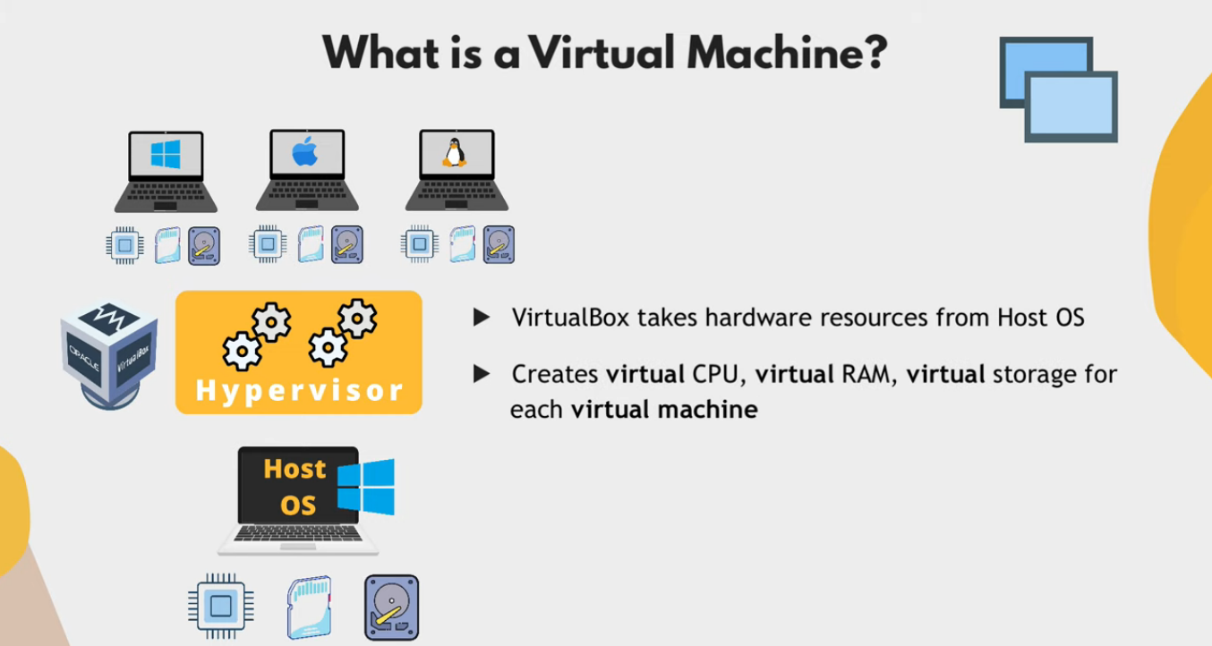

Slide 25
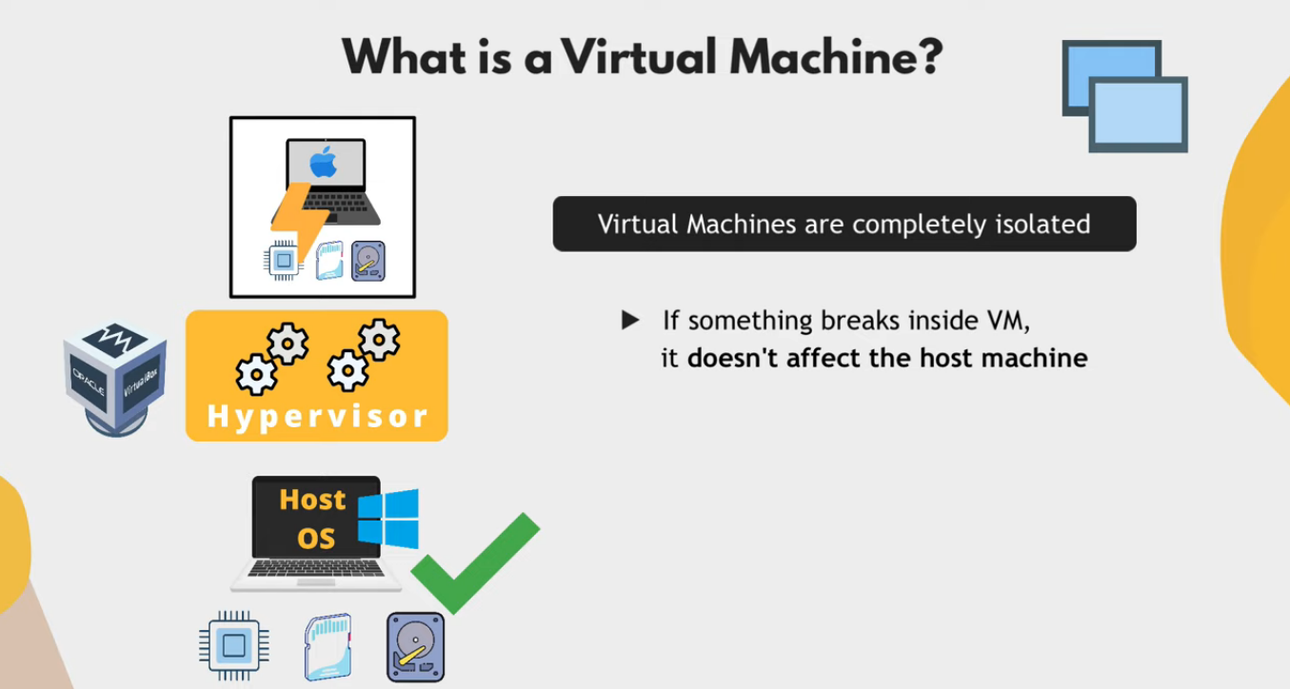

Slide 26
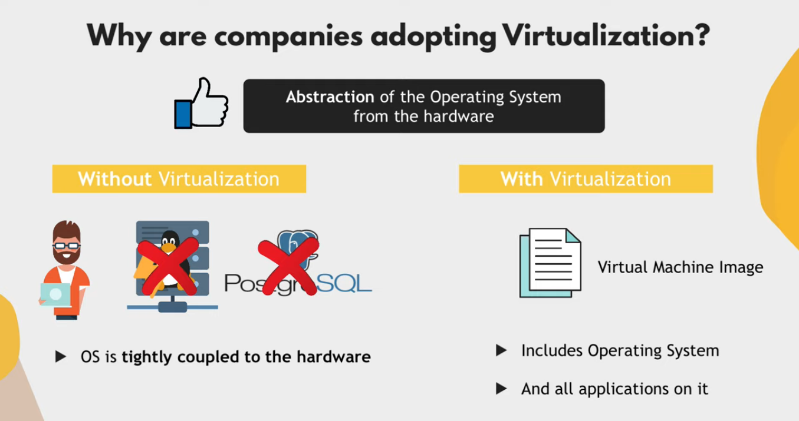

Slide 27
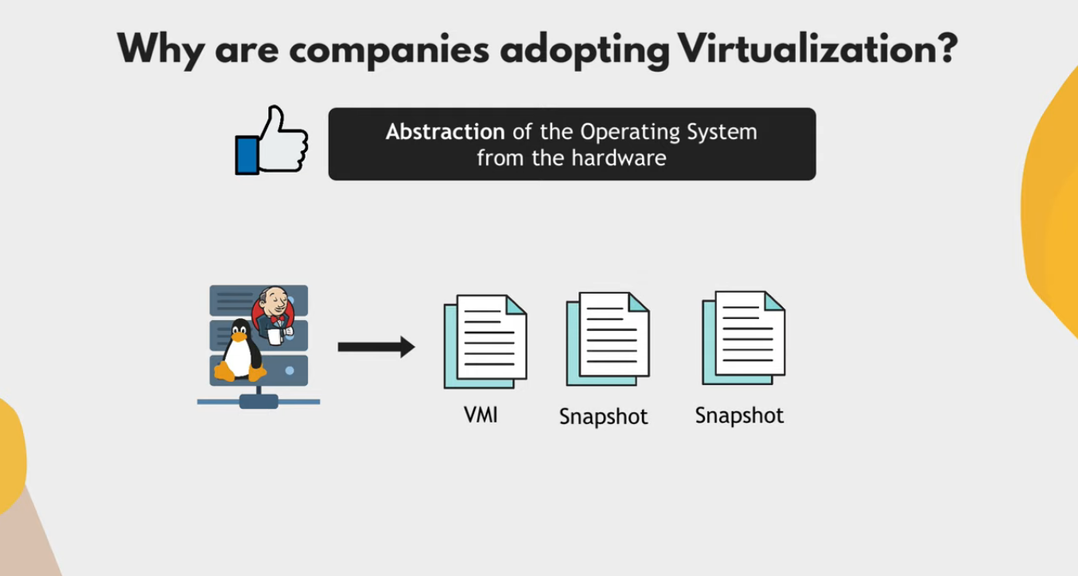

Slide 28
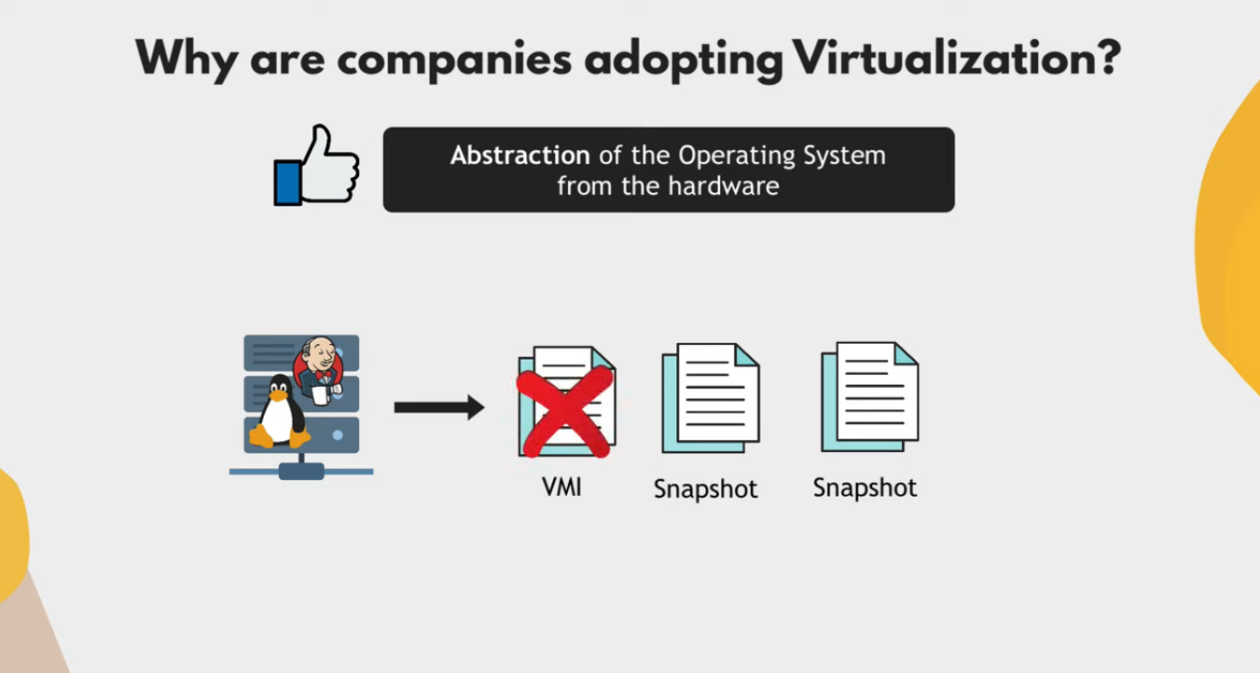
“Snapshot X”
“Time 0”
“Time 1”
“Time N”

Slide 29
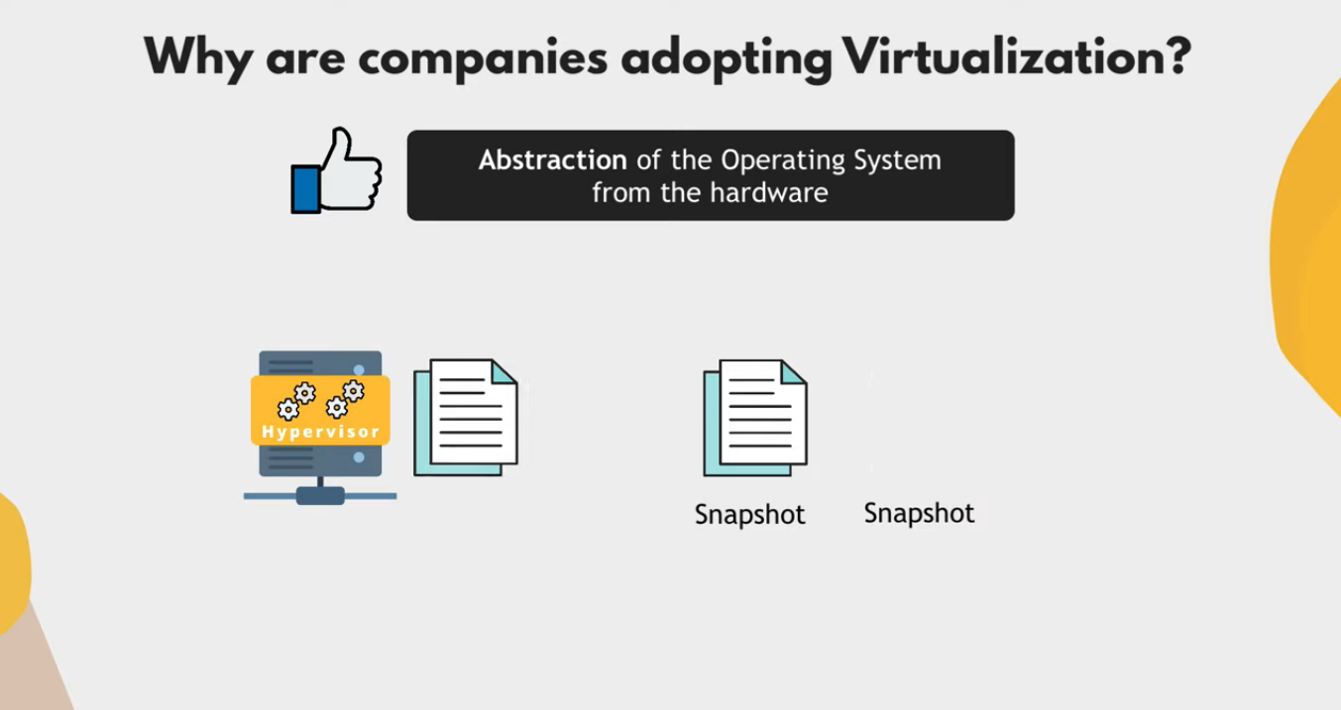

Slide 30
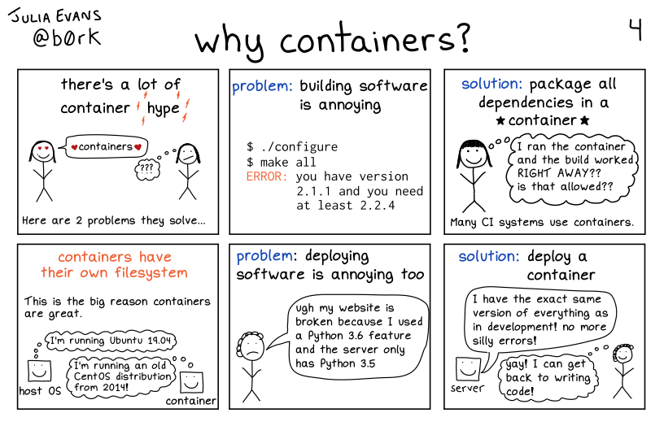

Slide 31
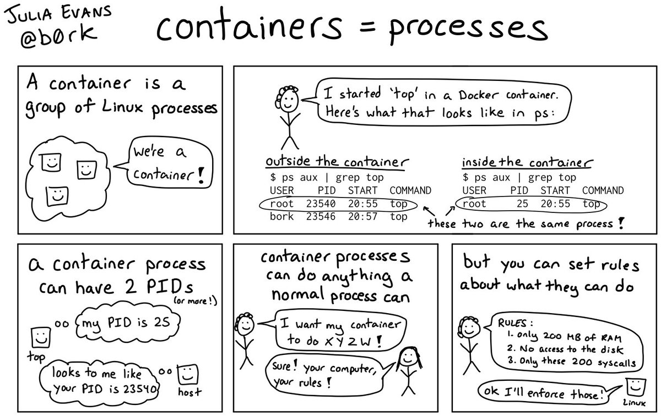

Slide 32
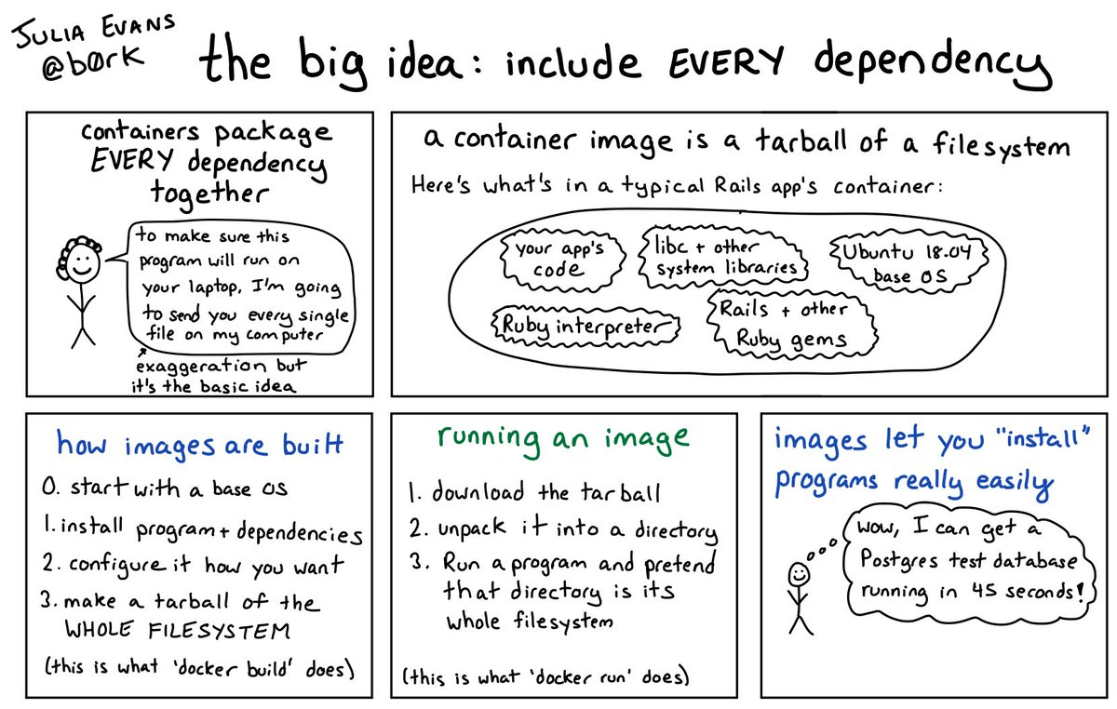

Slide 33
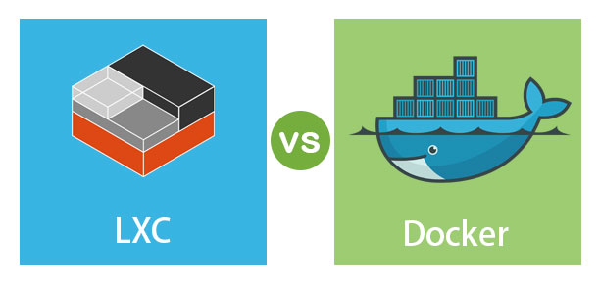

Slide 34
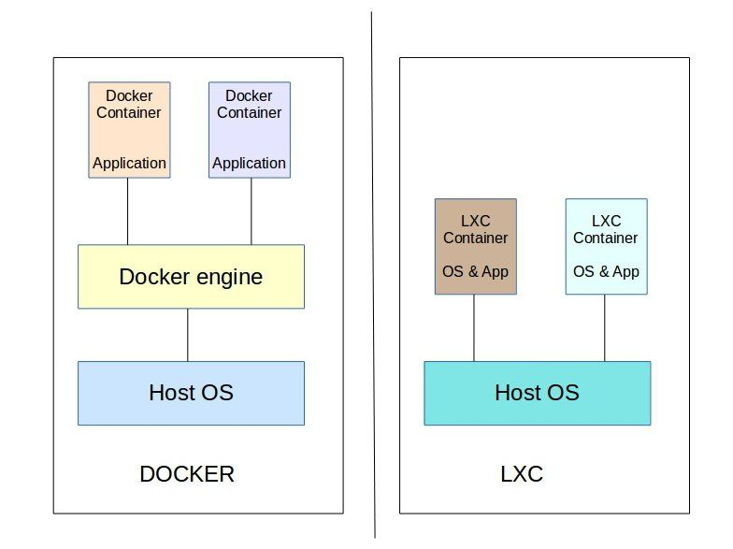
Linux containers (Lxc)
LXC is a user space interface for the Linux kernel containment features. Through a powerful API(LXD) and simple tools, it lets Linux users easily create and manage system or application containers. LXC containers are often considered as something in the middle between a chroot and a full fledged virtual machine. The goal of LXC is to create an environment as close as possible to a standard Linux installation but without the need for a separate kernel. Reference: https://linuxcontainers.org/lxc/introduction/

Slide 35
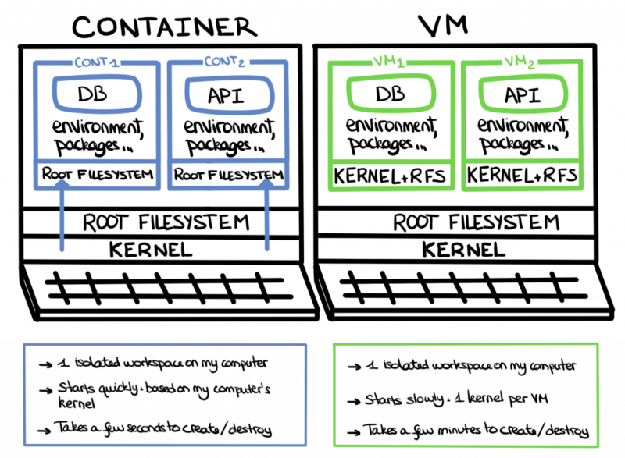
Containers uses the same host machine’s kernel instead of using a separate kernel but they have separate file systems.

Slide 36
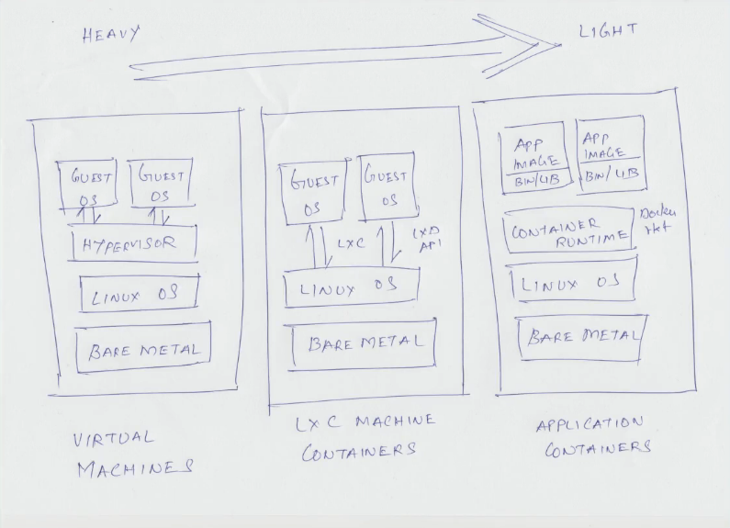

Slide 37
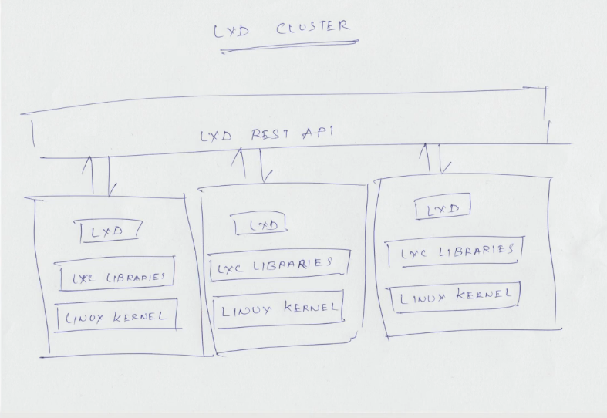

Slide 38
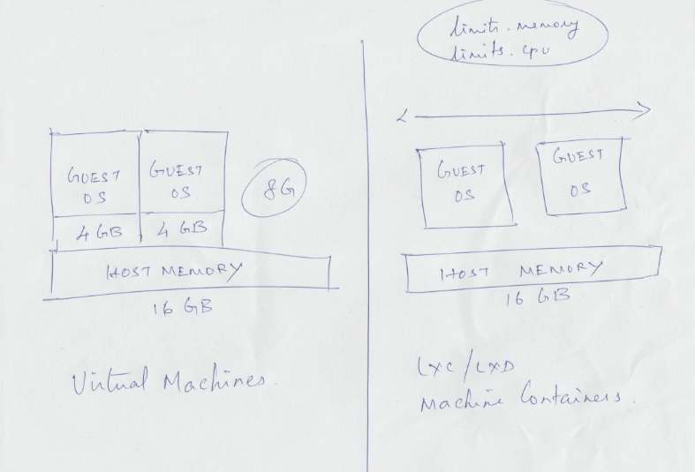

Slide 39
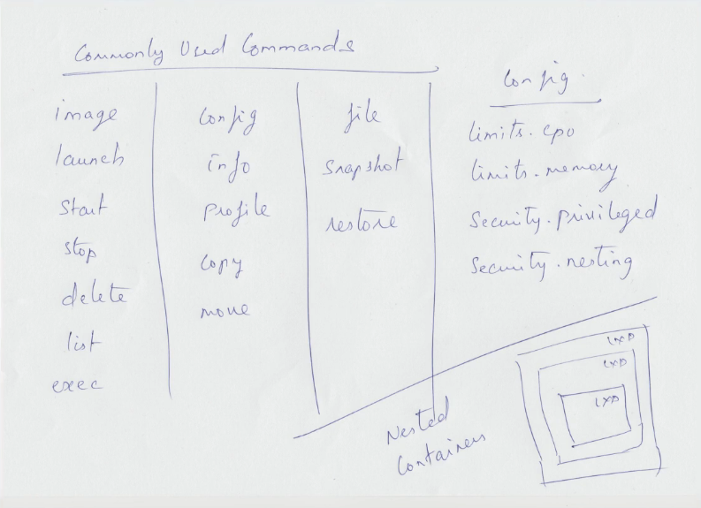

Slide 40
Virtual Machines - Heavy
- Fixed memory, and CPU cores for each GuestOS (Non-sharable). LXC using LXD REST API Interface
- Lightweight than VMs.
- Uses LXD API to make LXC containers. - Each GuestOS can use entire hardware resources together (Memory, and CPU cores).
- We can also limit memory, and CPU core just like VMs.
- Nested LXC containers are possible.
- Each GuestOS uses the same host OS Kernel.
- LXC containers are used for running multiple applications in an isolated environment.
- More Fast than VMs. - How to make an LXC? https://www.youtube.com/watch?v=CWmkSj_B-wo - More on LXC, https://www.upguard.com/blog/docker-vs-lxc Application Containers
- More lightweight than LXC.
- Uses same host machine kernel.
- Docker containers(Application containers) are made for running single application per container.
- No need to worry about RAM, Space, CPU and other resource allocations for contaienrs.
- Fast than LXC.

Slide 41
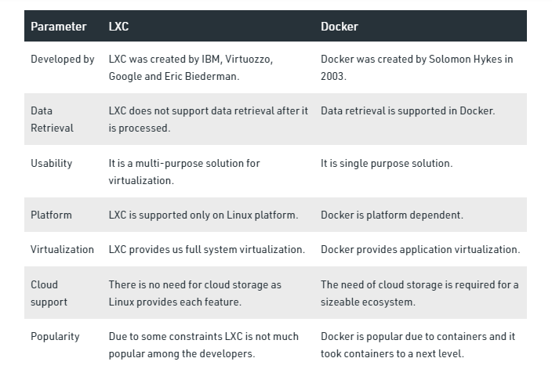

Slide 43
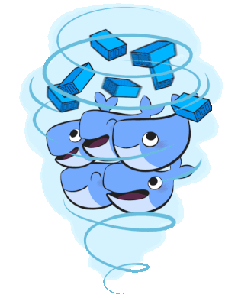
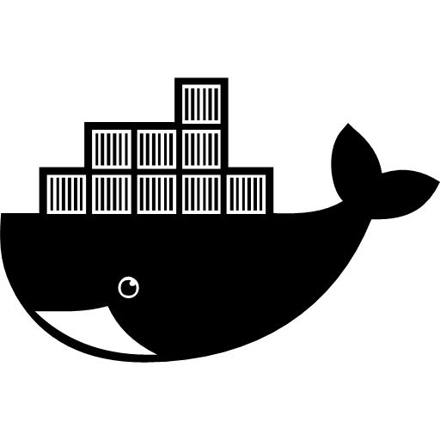
docker
Docker is a set of platform as a service products that use OS-level virtualization to deliver software in packages called containers. Containers are isolated from one another and bundle their own software, libraries and configuration files; they can communicate with each other through well-defined channels. – Wikipedia.

Slide 44
Working of Docker
docker → docker daemon → containerd → runC → unshare syscall

Slide 45
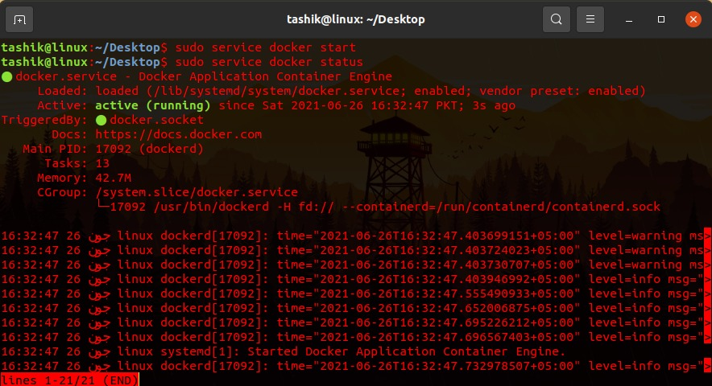
← Shows status of docker engine.

Slide 46

← Shows status of docker engine.

Slide 47

← Gives information about containers, version, driver, filesystem etc.

Slide 48

← Lists total images available at host machine.

Slide 49

← Removes all the “exited/stopped” containers.

Slide 50


← Removes all the images.

Slide 51

← Stops the running container.

Slide 52

← Removes container having any id/name __.

Slide 53


Slide 54



Slide 55


Slide 56



Slide 57


Slide 58


Slide 59


Slide 60


Slide 61


Slide 62

It is not an IP address of Host Machine.

Slide 63

To check host machine’s IP address.

Slide 64

host machine’s IP address.

Slide 65


Slide 66

First_webserver container’s IP address.

Slide 67


Slide 68

Second_webserver container’s IP address.

Slide 69


Slide 70

Host’s port 80 was not mapped with first_webserver container.

Slide 71

Host’s port 100 was mapped with second_webserver container.

Slide 72

To attach your terminal's standard input, output, and error (or any combination of the three) to a running container using the container's ID or name. This allows you to view its ongoing output or to control it interactively, as though the commands were running directly in your terminal.

Slide 73


Slide 74


Slide 75


Slide 76


Slide 77


Slide 78
Image creation methods

Slide 79


Slide 80


Slide 81


Slide 84
Docker Networking

Slide 85


Slide 86


Slide 87


Slide 88


Slide 89


Slide 90


Slide 91


Slide 92


Slide 93


Slide 94


Slide 95


Slide 96


Slide 97


Slide 98


Slide 99


Slide 100


